Slide 1

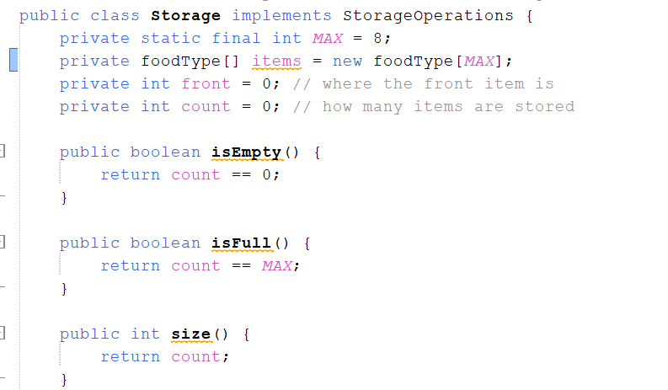
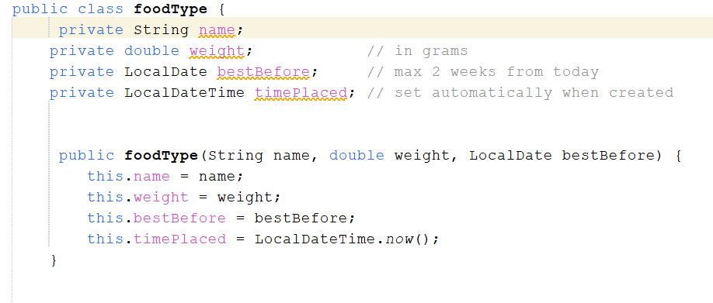
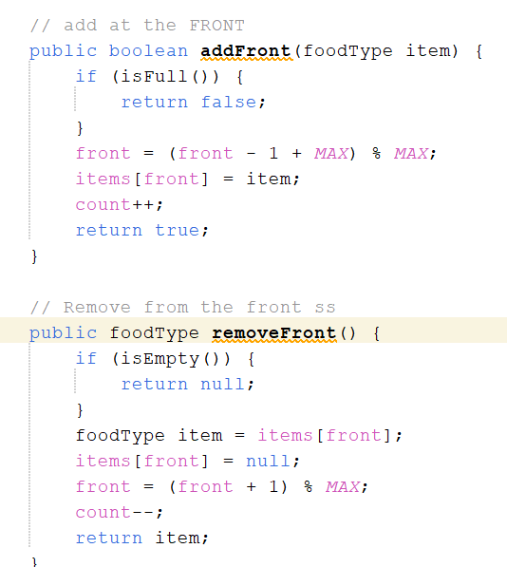
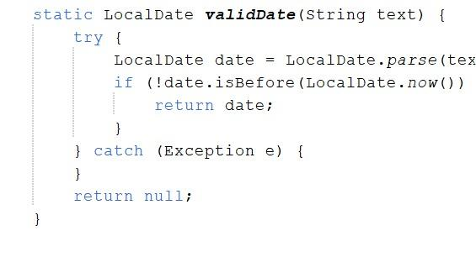
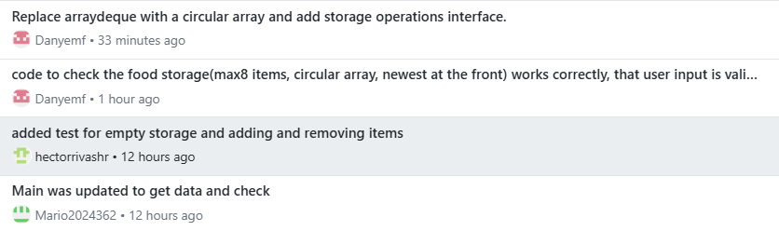
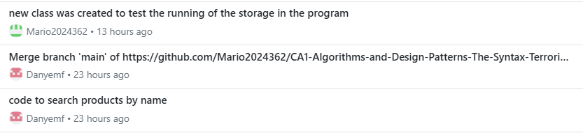
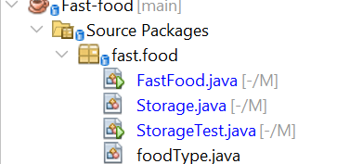
CA1:Circular Deque Storage Fast Food System
Students: Hector Rivas (2024352), Mario Cornejo (2024362) Daniel Montecinos (2024243)
Lecturer: Taufique Ahmed
GitHub: https://github.com/Mario2024362/CA1-Algorithms-and-Design-Patterns-The-Syntax-Terrorists-.git.
Video: https://drive.google.com/file/d/1ICiXo8AKgj2tBy_LoS-_Bld5Q4BoOcDe/view?usp=drivesdk.
1
The problem
3
Data structure: deque on a circular array
5
Running the application and validation
A food storage can hold at most 8 items. Each item has a name, a weight in grams and a best-before date but in the margin of 2 weeks. New items go in at the front, and items can be removed from the front or the back. This app must show the top item, reject invalid input, handle an empty storage and let the user exit after input any information.
A deque (double-ended queue) allows adding and removing at both ends.
An array of 8 slots, plus two numbers: front (index of the front item) and count (items stored).
The modulo operator % 8 makes the index wrap around: after slot 7 comes slot 0, so nothing is ever shifted.
Name must be Burger, Pizza, Fries, Sandwich or Hotdog (any capitalization).
Weight must be a number above 0.
Best-before date: YYYY-MM-DD, today up to 2 weeks ahead.
Empty or full storage prints a message instead of crashing when the data is not valid.
Visual representation for the storage as for demonstration after adding Pizza, Burger, Fries into the data.
0
BACK
remove back here
Pizza
[7]
1
Burger
[6]
array of 8 slots
2
front = 5
count = 3
back = (5+3-1)%8 = 7
Fries
[5]
3
Why this structure fits
FRONT
add / remove / peek here
4
Fixed capacity of 8, so an array needs no resizing.
A plain array would shift items when adding at the front; the circular array only moves an index
Both ends are needed, so a deque fits better than a stack or queue.
Shaded = stored item. Number in brackets = array slot.
2
Classes (OOP)
Github commits showing the program development
Food: name and weight of the food that was input (private fields, encapsulation)
foodType extends Food: adds best-before date and time stored for the food(inheritance)
Storage: the circular-array deque, max 8 items that keep the food that is set into the menu
FastFood: menu loop and input validation
StorageTest: automatic PASS / FAIL checks for every input that has been made
4
Algorithms and time complexity
Operation | Time | Reason
Add front | O(1) | Move front back one step, store item
Remove front | O(1) | Read item, move front forward
Remove back | O(1) | Back index computed directly
Peek | O(1) | Read items from the front
Search | O(n) | Linear scan, items are unsorted
Display | O(n) | Visits every item once
6
Advantages and limitations
Advantages
Limitations
add, remove and peek
Works at both ends
Fixed memory, no shifting
Fixed capacity of 8
No sorting by best-before date
No removal from the middle
References: Oracle (n.d.) ArrayDeque (Java SE 17 & JDK 17). Available at: ArrayDeque (Java SE 17 & JDK 17) (Accessed: 25 October 2026).
Oracle (n.d.) Lesson: Object-Oriented Programming Concepts, The Java Tutorials. Available at: Lesson: Object-Oriented Programming Concepts (The Java™ Tutorials > Learning the Java Language) (Accessed: 27 October 2026).
Wikipedia (n.d.) Circular buffer. Available at: Circular buffer - Wikipedia (Accessed: 30 October 2026).

